Slide 1
SCRUTINIZING MANIFOLDS STIPULATIONS BY LINEAR KERNEL
Anushiya V[211418104022]
Akshitha Ravi[211418104015]
PROJECT GUIDE : Mrs.S.T.Santhanalakshmi
DESIGNATION: Assistant Professor

Slide 2
INTRODUCTION
Nowadays, the car manufacturing industry faces more demands delivering more cars within a short span and with good condition, so for a genuine car performance we must provide the best engine. The reliability of the manufacturing sector is to present the best engine for the car and also for a smooth-running engine the specifications must be fulfilled. The engineer presents the engine performance features and the manufacturing team provides the layout of the engine.So the design will have many specifications which need to be filled for the best performance. The vendor can upload the individual engine designs. Once the design is uploaded, the engineer inspects the designs of the various vendors and decides the best design by working on the multiobjective obstacle. But fitting the best design by succeeding the multiple specifications is challenging, as the specifications vary. To sort out this issue we implemented the linear SVC algorithm. We can acknowledge the best design and can assemble the specific engine from the selected vendor. This is not only for achieving the best design but is to visualize the whole process of car manufacturing where we can enhance efficiency for the completion.

Slide 3
LITERATURE SURVEY
AUTHORS | TITLE OF THE PAPER | METHODOLOGY
X. He, Y. Zhou, Z. Chen and Q. Zhang | Evolutionary Many-Objective Optimization Based on Dynamical Decomposition | Based on this strategy, a solution ranking method, named dynamical-decomposition-based ranking method (DDR), is proposed which can be employed in the mating selection and environmental selection in commonly used algorithm frameworks.

Slide 4
AUTHORS | TITLE OF THE PAPER | METHODOLOGY
2. Dong Han, Wenli Du, Wei Du, Yaochu Jin, Chunping Wu, | An adaptive decomposition-based evolutionary algorithm for many-objective optimization, Information Sciences | This paper proposes an adaptive decomposition-based evolutionary algorithm for many-objective optimization, which introduces one adaptation mechanism for PBI-based decomposition and the other for adjusting the weight vector.

Slide 5
AUTHORS | TITLE OF THE PAPER | METHODOLOGY
3. M. Jafari, L. Daryani and M. Feizi-Derakhshi | A Prior Preference-Based Decision-Making Algorithm in Pareto Optimization | In this paper, we propose a lightweight angle-based updating Pareto front (PF) algorithm which considers the preferences of desired objectives expressed using the Favorite Region (FR). Actually, the FR has been created in the objective space according to the prior-fixed angle of priority objectives. Thus, the solutions in PF will be able to tend towards FR during the evolutionary process

Slide 6
AUTHORS | TITLE OF THE PAPER | METHODOLOGY
4. Y. Wan, H. Cui, Y. Liu and R. Cong | A Visualization Framework of Pareto Optimization for Decision Making | We propose a framework to visualize the Pareto optimization such that the tradeoffs are clearly seen and easily turned into decision. Since the number of criteria is large, we first divide the criteria into 2-pair groups. This could assist users to make better comparison. To obtain more broader view and make more correct decision, we divide the criteria into 3-pair groups and then visualize them with a 3D surface. Finally, with the case studies, it turns out our framework is useful for the multi-criteria decision making

Slide 7
AUTHORS | TITLE OF THE PAPER | METHODOLOGY
5. A. Brik, L. Labrak, L. Carrel, I. O’Connor and R. Iskander | Fast extraction of predictive models for integrated circuits using n-performance Pareto fronts | . In this paper, we present a method to extract predictive models efficiently for electronic subsystems based on Pareto fronts. We use a very fast design and migration software called ID-Xplore to generate the performance space of sub-blocks in order to generate Pareto fronts for any block, thereby circumventing the traditional use of numerical optimization and thus accelerating the generation of Pareto-fronts for n-performance

Slide 8
PROBLEM STATEMENT
At present, the automobile industry is under more pressure to provide more automobiles in a shorter period of time and in good condition, therefore we must give the greatest engine for true car performance. The manufacturing sector's dependability is to deliver the best engine for the car, and requirements must be met for a smooth-running engine. The engine performance features are presented by the engineer, and the engine layout is provided by the manufacturing team. As a result, the design will include a number of specifications that must be filled in for the greatest results. Individual engine designs can be uploaded by the vendor. After the design is uploaded, the engineer examines the designs of the various vendors and selects the best design by utilizing the multi-objective obstacle. However, fitting the best design by meeting various standards is difficult because the specifications differ. The designs are displayed in the state of the most pleasing specifications of the corporate design, and even if one design is dropped, we may accomplish the second-best design using linear svc and continue the process without a halt. It assists in properly resolving the commitment. We may sort out the discontinuation of manufacturing and improve the performance of the classification of the designs given by various types of vendors by using this technology.

Slide 9
DEVELOPMENT ENVIRONMENT
HARDWARE REQUIREMENTS
Processor : i3, i5, i7
Speed : 2.3 GHz
RAM : 4 Gb
Hard Disk : 260 GB
SOFTWARE REQUIREMENTS
Front end : Core Python, CSS, JS
Web application : Django, Flask
Back end : MySQL

Slide 10
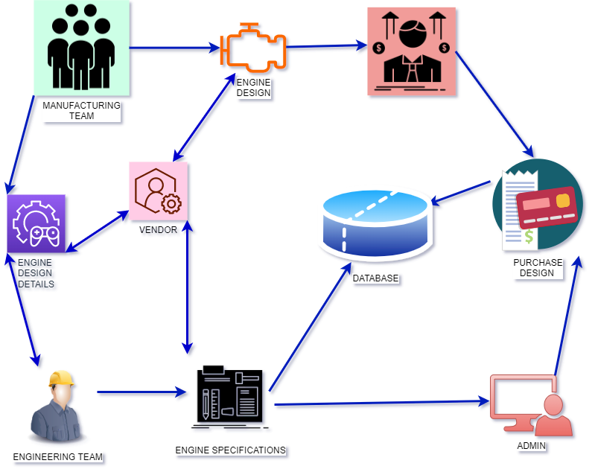
SYSTEM ARCHITECTURE

Slide 11
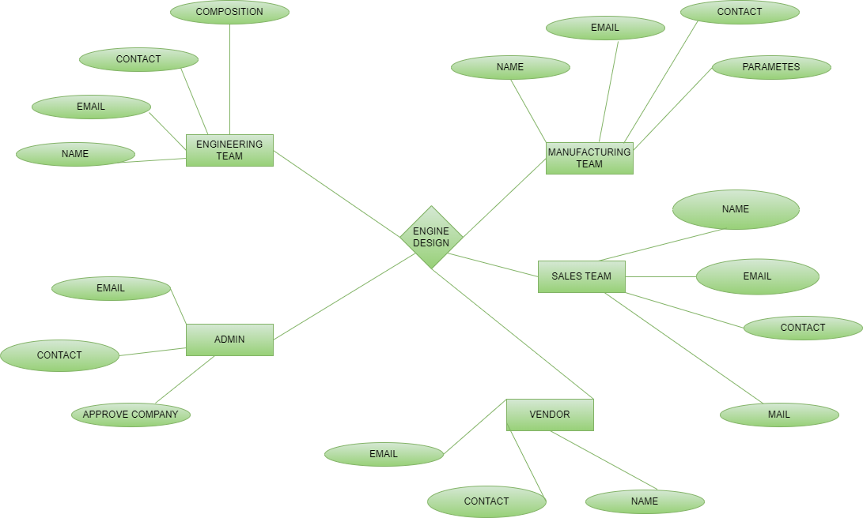
SYSTEM DESIGN ENTITY – RELATIONSHIP DIAGRAM

Slide 12
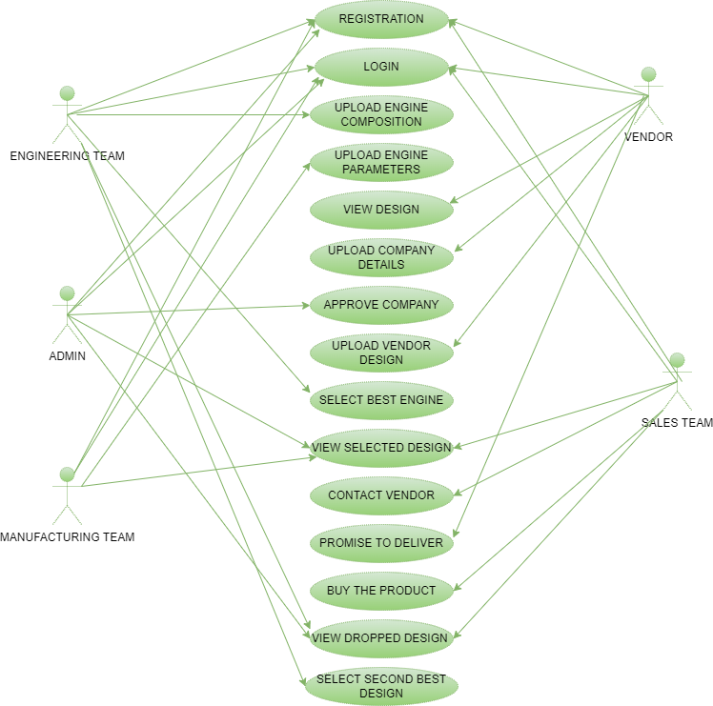
USE CASE DIAGRAM

Slide 13
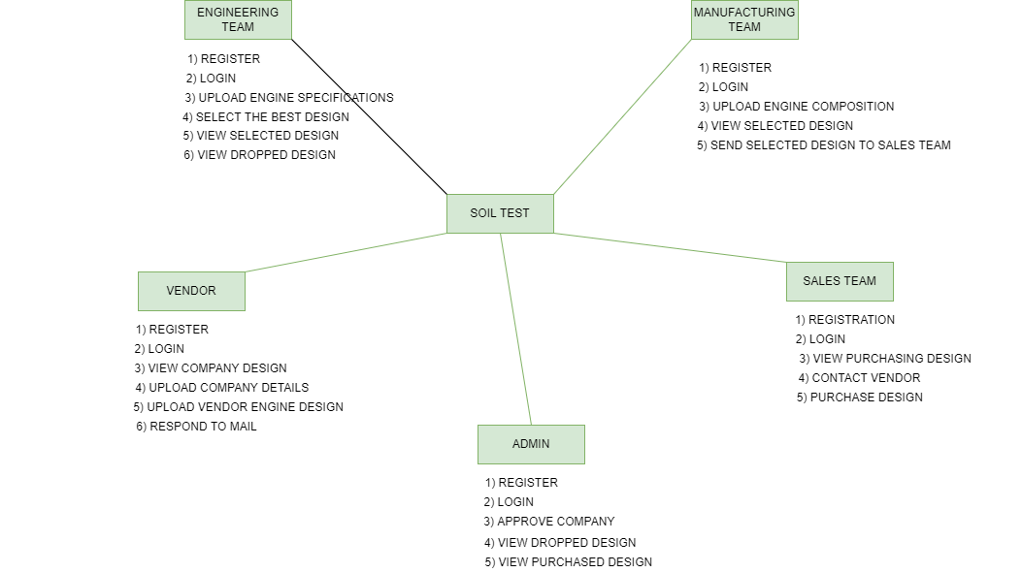
COLLABORATION DIAGRAM

Slide 14
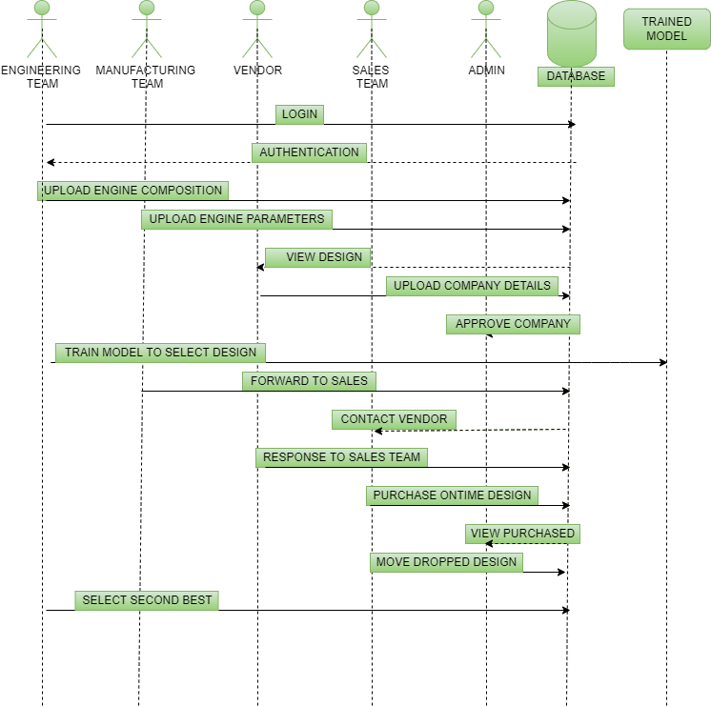
SEQUENCE DIAGRAM

Slide 15
MODULE DESCRIPTION
MODULES:
Engineering Team
Manufacturing Team
Sales Team
Vendor
Admin

Slide 16
ENGINEERING TEAM
This module gives the registration process with the engineer details of name, email id, contact number, and password. With this, the engineer can log in to the engineering team page. Within the engineering team module, there is another module called upload composition, view vendor design, view selected to design, and view dropped. After the login process in the engineering team module engineer can upload the required composition for engine design like power, horsepower, maximum power, and torque. In the view vendor design, the engineering team can view the engine designs of the vendors and select the best design for the engine. In the view selected design, the engineering team views the selected best design for further process. In the view dropped design the engineering team will view the design not provided by the vendor at the time and in the module view vendor design module, the engineering team will view the second-best design and select the design of the vendor.

Slide 17
MANUFACTURING TEAM
After registration, the manufacturing team can log in to the manufacturing team page. Within the manufacturing team module, there are sub-modules named upload composition, view selected and select design. In the sub-module named upload composition, the manufacturing team can upload the engine design details like engine type, displacement, cylinders, bore, stroke, compression ratio, and turbo details followed by the upload of the engineering team. In the module named view selected the manufacturing team see the vendor selected by the Engineering Team. In the module named selected design table, the manufacturing team can view the details of the engine design of the selected vendor with each specification of the engine by the engineering team and forward it to the sales team.

Slide 18
SALES TEAM
This module gives the registration process with the sales team details of name, email id, contact number, and password. After registration, the sales team can log in to the respective page. Within the sales team module, there are sub-modules named design selected, contact vendor, buy design, and view dropped. In the table named view selected sub-module, the sales team can view the design selected by the engineer and forwarded by the manufacturing team. In the contact vendor module, the sales team will contact the vendor whose design is selected as the best and send the information regarding buying the engine through the mail. In the module, buy design the sales team can buy the engine once the response is received from the vendor side. In the view dropped module, the sales team can view the engine design which the vendor failed to deliver and forward it to the admin

Slide 19
VENDOR
This module gives the registration process with the vendor details of name, email id, contact number, and password. After registration, the vendor can log in to the respective page. Within the vendor module, there are sub-modules named view design, company details, upload design, and respond to mail. In the table named view to design the vendor can view the engine details uploaded by the engineering and manufacturing team of the company. In the module named company details the vendor can upload the company details and upload it to admin. In the module named upload design, each vendor can upload each individual and different designs designed by the vendor. In the module named to respond to mail, the vendor can respond to the mail sent by the sales team either by promising of delivering the product on time or by replying to the design that cannot be delivered.

Slide 20
ADMIN
This module allows the admin to login into the admin page and views the overall work. In the admin module, there are sub-modules named select company, purchased design and dropped design. In the module named select company, the admin either selects or rejects the vendor’s company. In the module, named purchased design in the form of a table, the admin can view the design which is selected by the engineering team and which is purchased from the selected vendor by the sales team. In the module named dropped design in the form of a table, the admin can view the design forwarded by the sales team which the vendor failed to deliver on time. And admin views the dropped design and forwards it to the engineering team to finish the process soon by selecting the second-best design.

Slide 21
PERFORMANCE EVALUATION

Slide 22
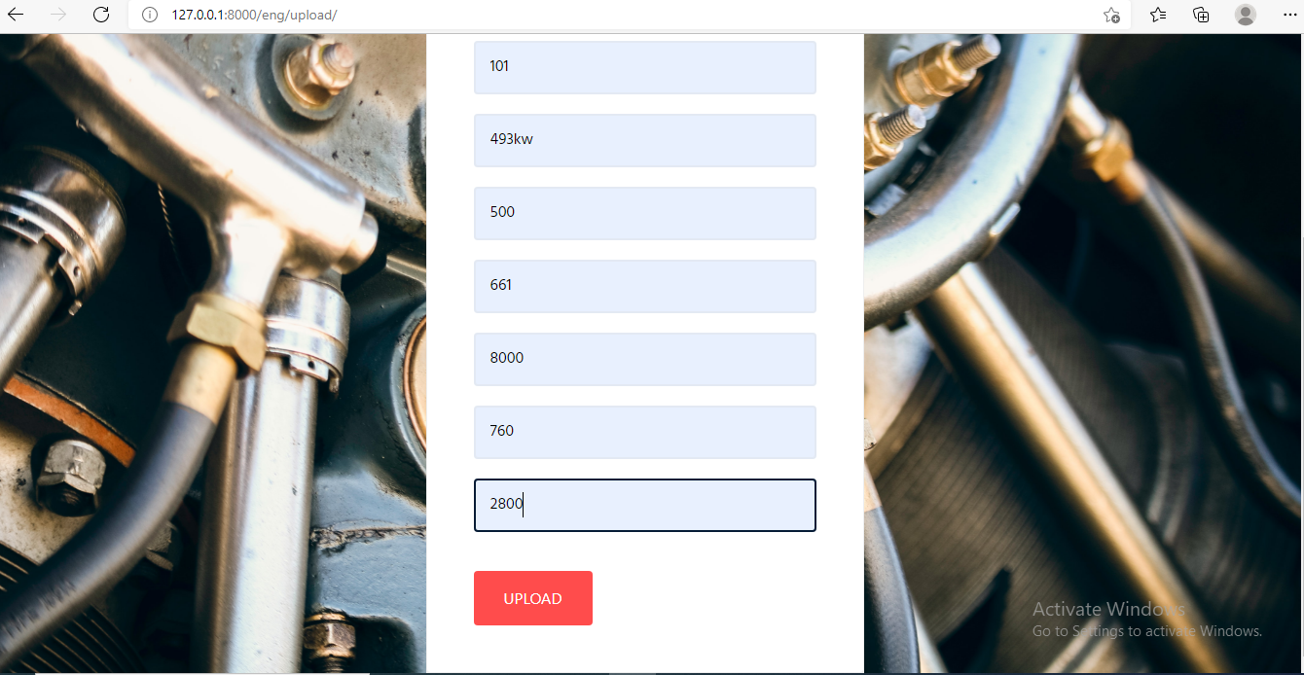
SCREENSHOTS

Slide 23
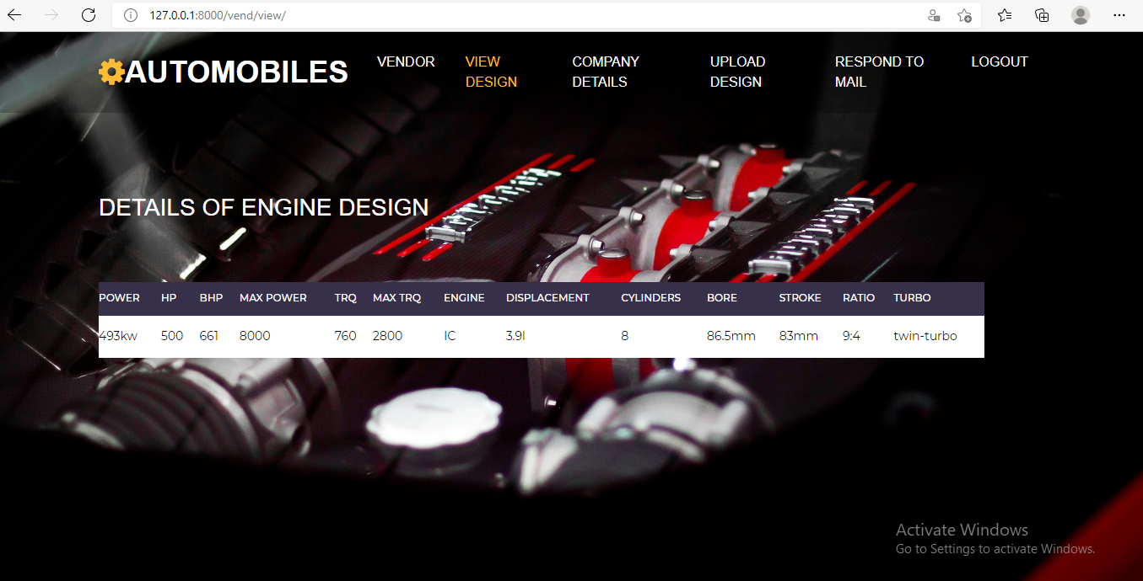

Slide 24
CONCLUSION
In this project, the best design selection for the car manufacturing industry has an outstanding role. So the first best design of the vendor is achieved by applying the Linear Support Vector Classification algorithm and though when the vendor fails to supply the needs. Then the recommendation for the second best is chosen for the completion of the project based on the classification process by using the linear kernel. In this approach, we can choose the outstanding design by covering all the multiple specifications.

Slide 25
REFERENCES
D. Han, W. Du, W. Du, Y. Jin, and C. Wu, “An adaptive decomposition based evolutionary algorithm for many-objective optimization,” Inf. Sci., vol. 491, pp. 204–222, Jul. 2019.
D. Sudholt, “How crossover speeds up building-block assembly in genetic algorithms,” Evol. Comput., vol. 25, no. 2, pp. 237–274, 2017
F. Daolio, A. Liefooghe, S. Verel, H. Aguirre, and K. Tanaka, “Problem features versus algorithm performance on rugged multiobjective combinatorial fitness landscapes,” Evol. Comput., vol. 25, no. 4, pp. 555–585, 2017.
H. Ishibuchi, Y. Setoguchi, H. Masuda, and Y. Nojima, “Performance of decomposition-based many-objective
algorithms strongly depends on Pareto front shapes,” IEEE Trans. Evol. Comput., vol. 21, no. 2, pp. 169–190, Apr. 2017.
R. Tanabe and H. Ishibuchi, “An analysis of control parameters of MOEA/D under two
different optimization scenarios,” Appl. Soft Comput., vol. 70, pp. 22–40, Sep. 2018
R. Wang, J. Xiong, H. Ishibuchi, G. Wu, and T. Zhang, “On the effect of reference point in MOEA/D
for multi-objective optimization,” Appl. Soft Comput., vol. 58, pp. 25–34, Sep. 2017.
R. Wang, Q. Zhang, and T. Zhang, “Decomposition-based algorithms using Pareto adaptive
scalarizing methods,” IEEE Trans. Evol. Comput., vol. 20, no. 6, pp. 821–837, Dec. 2016.
X. He, Y. Zhou, Z. Chen, and Q. Zhang, “Evolutionary many-objectiveoptimization based on
dynamical decomposition,” IEEE Trans. Evol.Comput., vol. 23, no. 3, pp. 361–375, Jun. 2019.
X. Ma, Q. Zhang, G. Tian, J. Yang, and Z. Zhu, “On Tchebycheff decomposition approaches
for multiobjective evolutionary optimization,” IEEE Trans. Evol. Comput., vol. 22, no. 2, pp. 226–244,
Apr. 2018
10. Y. Xiang, Y. Zhou, M. Li, and Z. Chen, “A vector angle-based evolutionary algorithm for unconstrained
many-objective optimization,” IEEE Trans. Evol. Comput., vol. 21, no. 1, pp. 131–152, Feb. 2017

